Slide 1
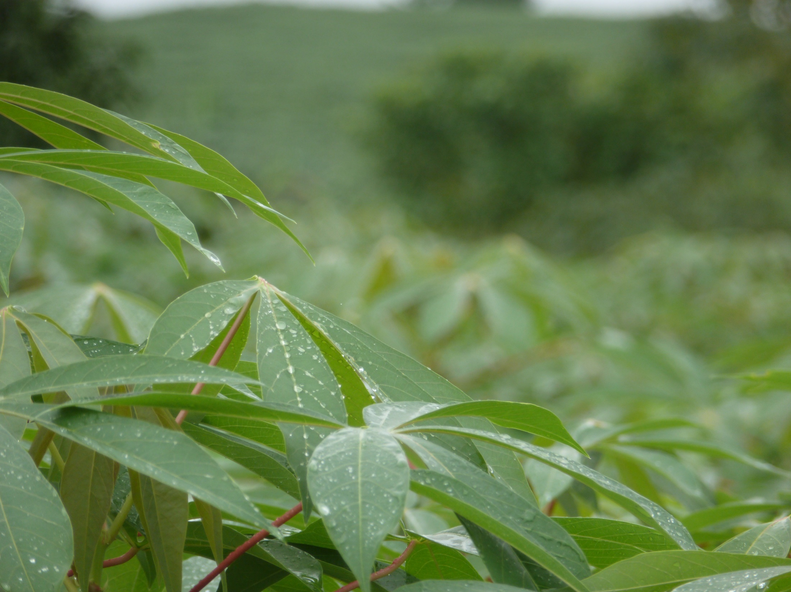
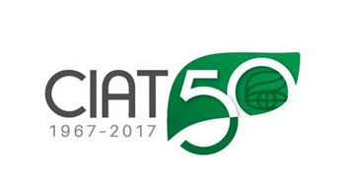
Inventory, distribution & management of disease resistance germplasm from CIAT: CMD and other cassava diseases
Hernán Ceballos
Introduction: the honeymoon is over
Management options
Deployment of resistant varieties
➢ Introduced germplasm
➢ Development of CMD resistant clones
Introduction: the honeymoon is over
Management options
Deployment of resistant varieties
➢ Introduced germplasm
➢ Development of CMD resistant clones

Slide 2
Inventory, distribution & management of disease resistance germplasm from CIAT: CMD and other cassava diseases
Hernán Ceballos
Introduction: the honeymoon is over
Management options
Deployment of resistant varieties
➢ Introduced germplasm
➢ Development of CMD resistant clones
Introduction: the honeymoon is over

Slide 3
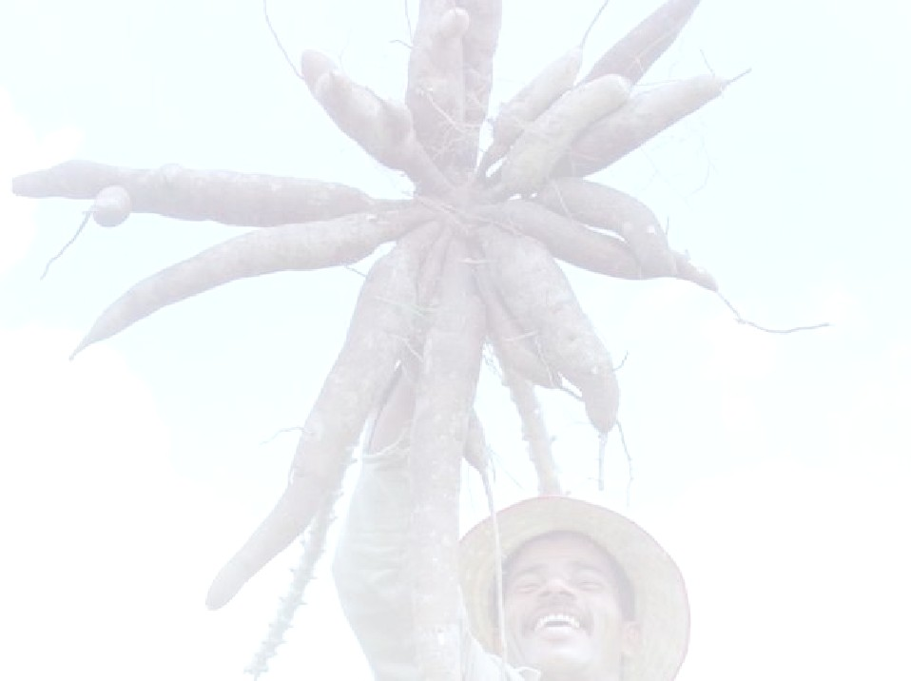
SE Asia was a “blessed paradise” for cassava
However, we have managed to destroy “paradise”
We have not taken seriously witches broom (a problem that we have had for two decades now)
… along with the quick deployment of its biological control.
Then mealy bug was introduced about 10 years ago
Probably this success gave us too much confidence !!!
Then CMD was introduced either to Cambodia or Vietnam
CMD is indeed a huge problem and is NOT as easy to deal with as the mealy bug was
The bad news is that, to face this threat, people may eventually bring in new strains of CMD and, even worse, introduce cassava brown streak virus (CBSD)

Slide 4
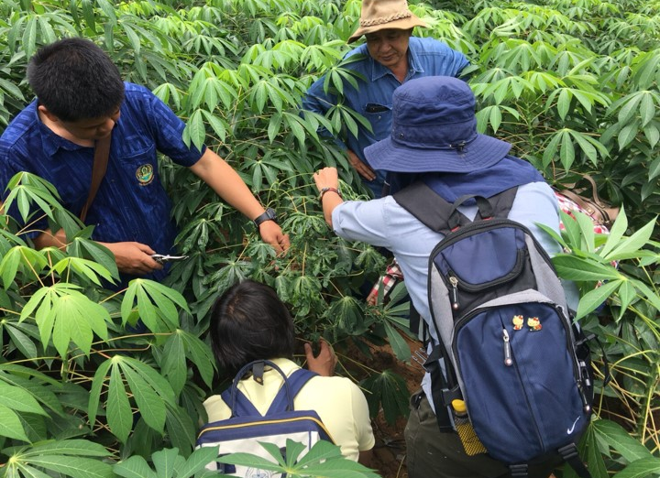
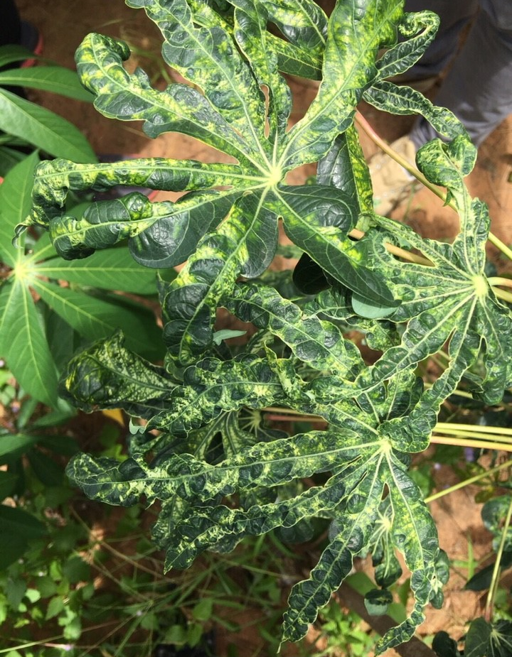
Our views (hopes) on the CMD threat to Thailand
(a year ago)
CMD seems has now landed in Thailand
The spread of CMD will be slow
Whiteflies in SE Asia are not as aggressive and efficient transmitting CMD as those in Africa
The single strain of CMD introduced is not as aggressive and yields will not be decreased as badly as in Africa
We will find some degree of tolerance to CMD in Asian released varieties or germplasm

Slide 5
Incidence of CMD in elite cassava germplasm
SC8
Rayong 11
Rayong 11
HB60
KM 98-1
Rayong 5
Rayong
72
KU50
Certainly there is genetic variation for the reaction to CMD
… but let´s accept that what we have IS NOT enough

Slide 6
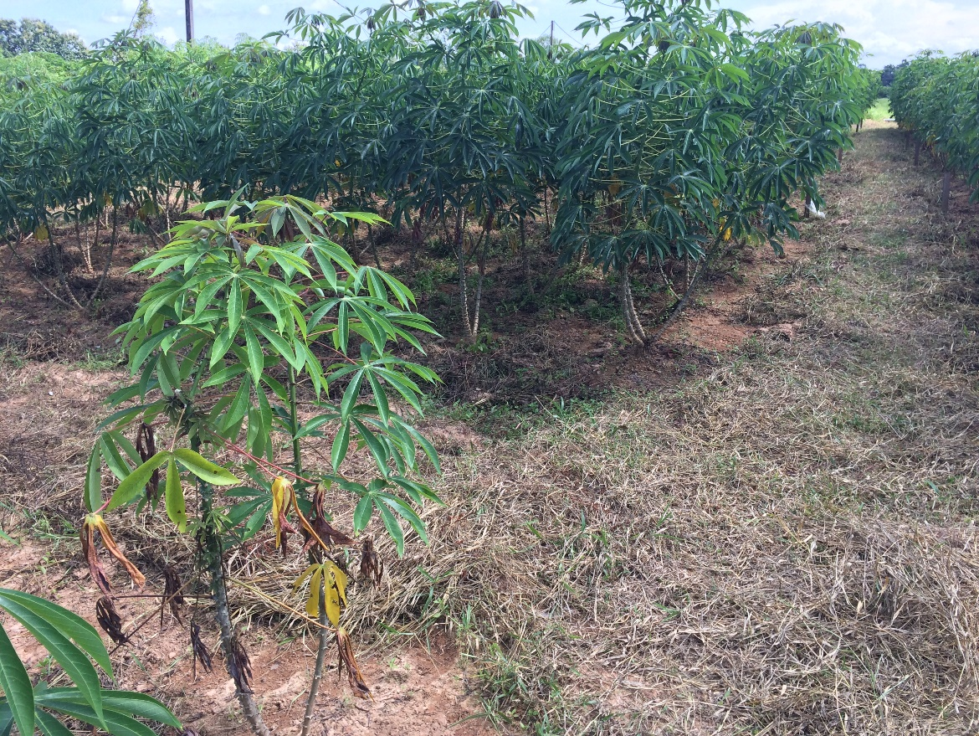
But we have some good news
Although Rayong 11 is VERY susceptible to CMD, it is becoming clear that it has tolerance (or resistance) to witches broom disease
Rayong 11
Genotype susceptible to witches broom disease
We had already introduced sources of resistance to CMD
We have the valuable help from IITA (knowledge & clones)
ACIAR (Australia) is providing financial support

Slide 7
Key characteristics of CMD:
Induced by a gemini virus
There are many strains of the virus
Mixed infections (>than 1 strain) cause more damage
Transmitted by whiteflies (persistent transmission)
Also transmitted through cuttings from diseased plants
There is a reliable source of resistance (CMD₂), which is based on a major (dominant) gene.
Molecular markers are available to track the gene(s)
Key characteristics of CMD in SE Asia:
There is only one strain identified (Sri Lankan CMD)
Is whitefly pressure in SE Asia lower than in Africa? Does it matter?
All germplasm so far evaluated is susceptible (although there are clear genetic differences in the degree of susceptibility)

Slide 8
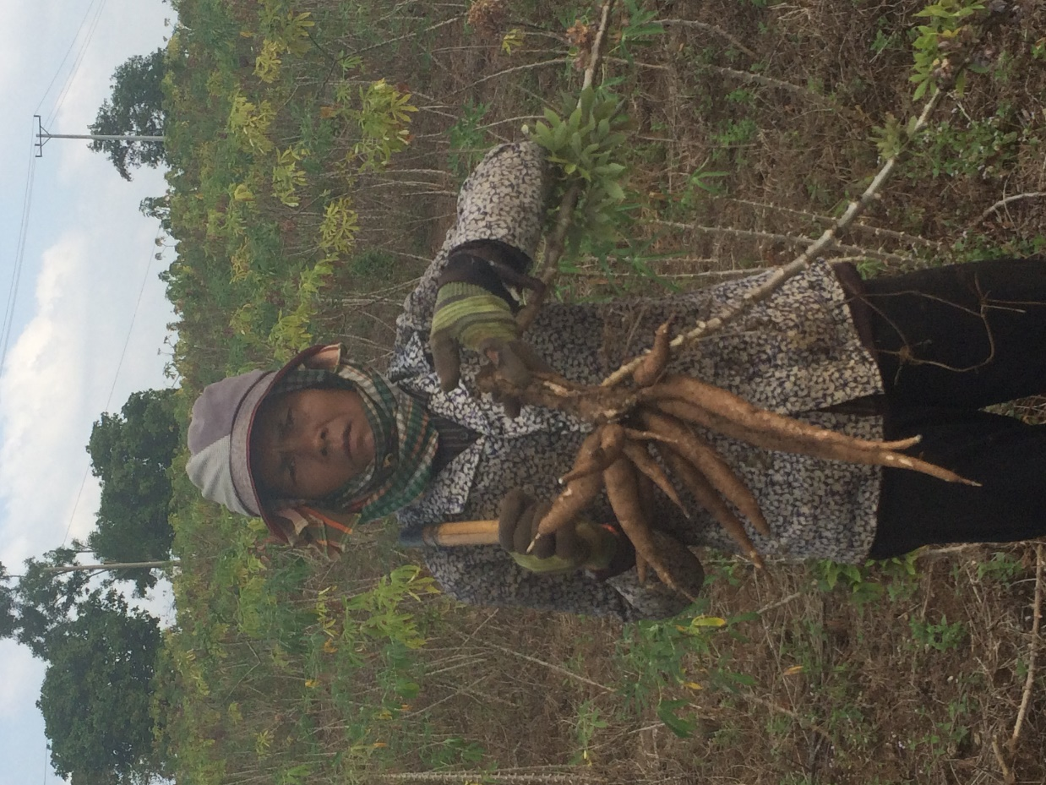
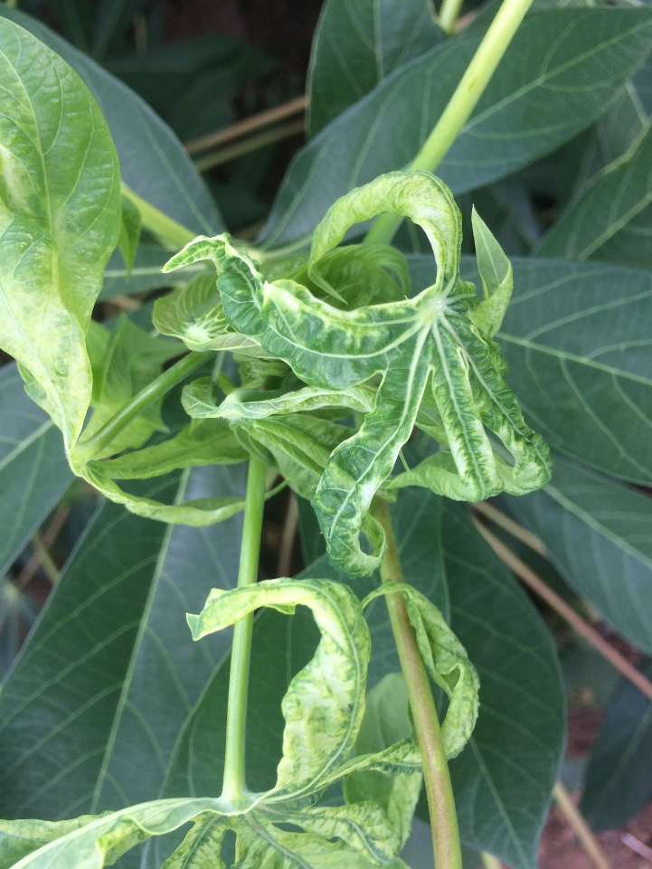
Our options
“Managing” the disease
The ultimate management: deploying CMD-resistance

Slide 9
Inventory, distribution & management of disease resistance germplasm from CIAT: CMD and other cassava diseases
Hernán Ceballos
Introduction: the honeymoon is over
Management options
Deployment of resistant varieties
➢ Introduced germplasm
➢ Development of CMD resistant clones
Management options

Slide 10
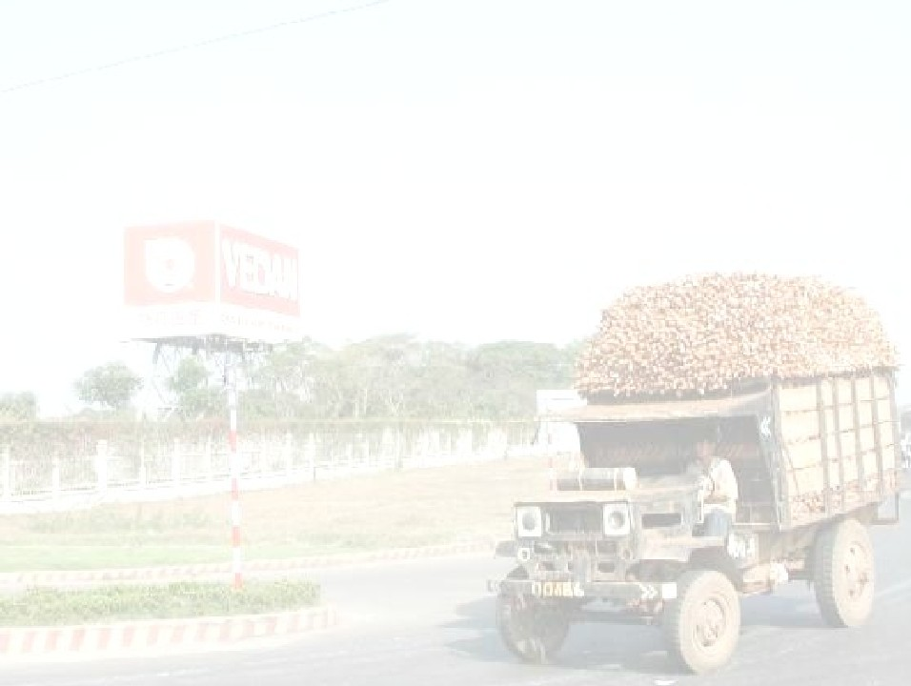
Strategies to overcome the CMD problem
Proper management of planting material:
Transmitted through cuttings from diseased plants
Positive selection: DO NOT take cuttings from diseased plants
➢ DO NOT purchase planting material from unknown sources
Eliminate plants from the field as they show symptoms
Define the “corner of prosperity” (≈ 10% of the field), inspect it often, eliminate plants with symptoms, harvest plants just before planting time
Is the corner of prosperity effective ?

Slide 11
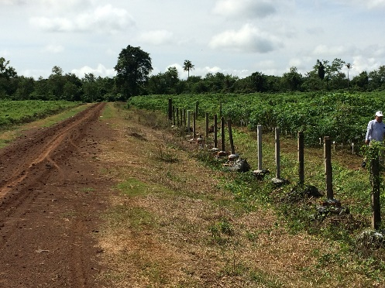
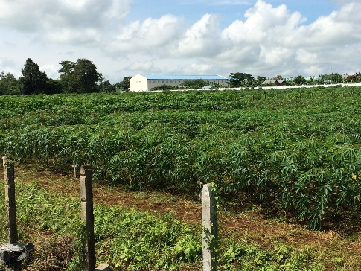
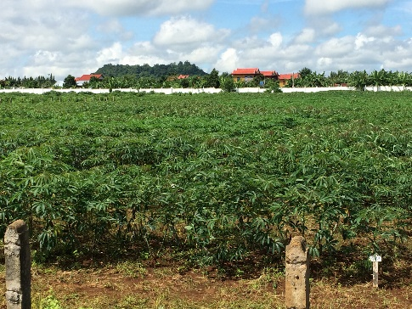
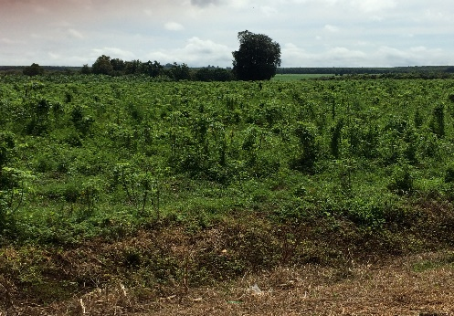
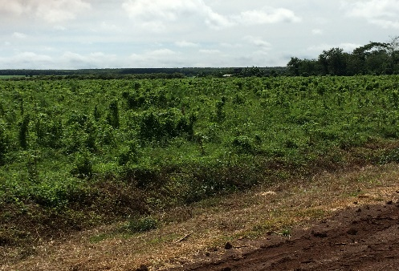
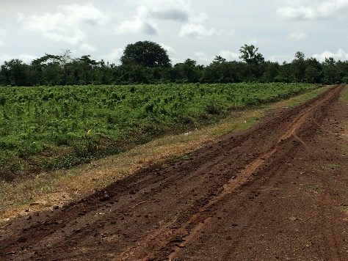
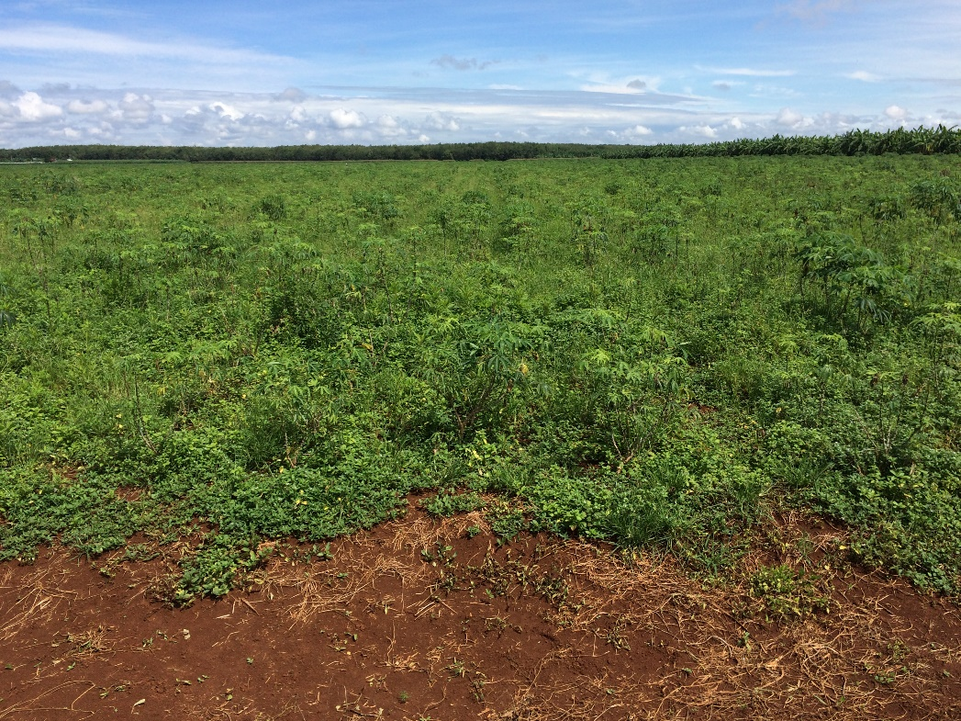
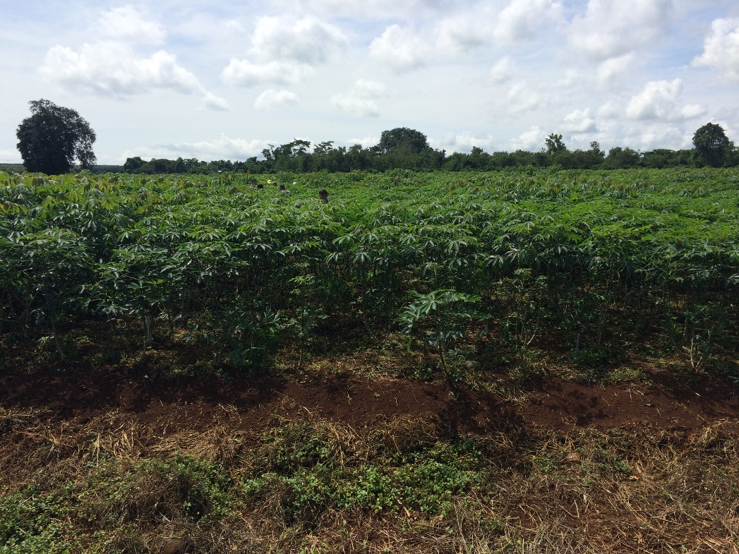
Strategies to overcome the CMD problem
Proper management of planting material:
Transmitted through cuttings from diseased plants
Positive selection: DO NOT take cuttings from diseased plants
➢ DO NOT purchase planting material from unknown sources
Eliminate plants from the field as they show symptoms
Define the “corner of prosperity” (≈ 10% of the field), inspect it often, eliminate plants with symptoms, harvest plants just before planting time
Is the corner of prosperity effective ?
These two plots were in front of each other divided by a narrow road

Slide 12
Strategies to overcome the CMD problem
Proper management of planting material:
Transmitted through cuttings from diseased plants
Positive selection: DO NOT take cuttings from diseased plants
➢ DO NOT purchase planting material from unknown sources
Eliminate plants from the field as they show symptoms
Define the “corner of prosperity” (≈ 10% of the field), inspect it often, eliminate plants with symptoms, harvest plants just before planting time
Is the corner of prosperity effective ?

Slide 13
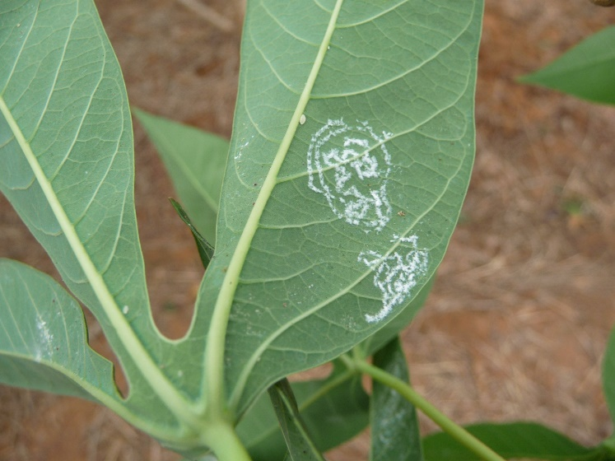
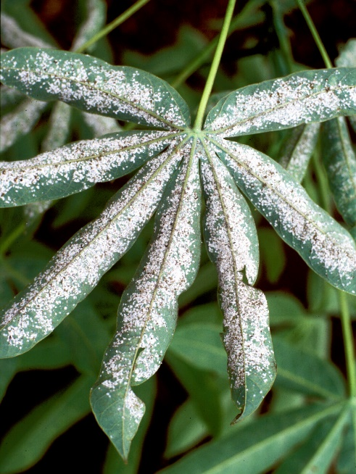
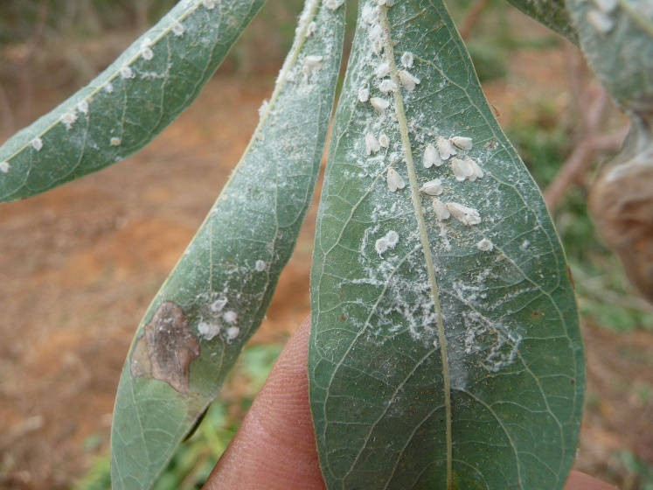
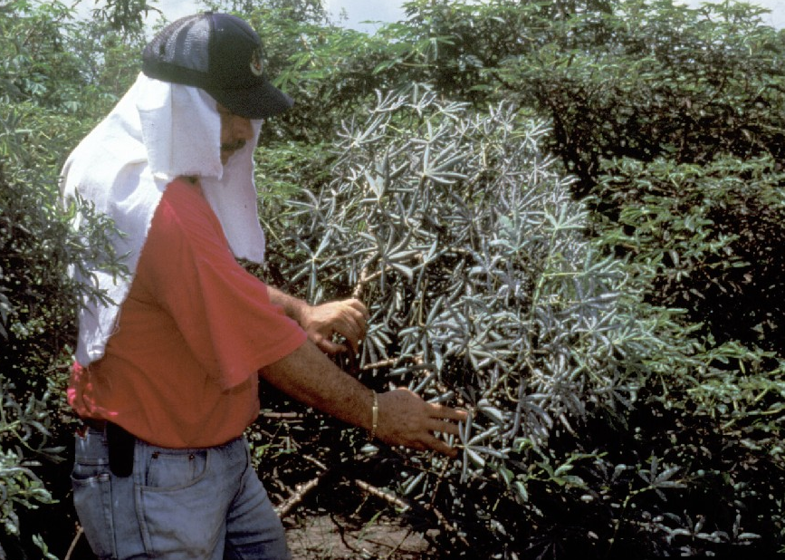
Strategies to overcome the CMD problem
Proper management of planting material:
Transmitted through cuttings from diseased plants
Positive selection: DO NOT take cuttings from diseased plants
➢ DO NOT purchase planting material from unknown sources
Eliminate plants from the field as they show symptoms
Define the “corner of prosperity” (≈ 10% of the field), inspect it often, eliminate plants with symptoms, harvest plants just before planting time
Is the corner of prosperity effective ?
The “corner of prosperity” works particularly when the rate of infection from diseased to healthy plants is low:
•Whitefly pressure is limited
•Is the efficiency of transmission by whiteflies feeding on cassava in SE Asia lower than that of Bemisia tabaci in Africa?

Slide 14
Strategies to overcome the CMD problem
Proper management of planting material:
Transmitted through cuttings from diseased plants
Positive selection: DO NOT take cuttings from diseased plants
➢ DO NOT purchase planting material from unknown sources
Eliminate plants from the field as they show symptoms
Define the “corner of prosperity” (≈ 10% of the field), inspect it often, eliminate plants with symptoms, harvest plants just before planting time
Is the corner of prosperity effective ?
Is it useful to control the whiteflies?
It may be useful to treat stem cuttings with systemic insecticides which
have been proven to protect plantlets for up to two months
CMD-resistant varieties:
The ultimate solution is the deployment of resistant varieties
The CMD₂ resistance is VERY effective, does not break (so far) and it is a single dominant gene (easy to handle). Already in Thailand

Slide 15
Inventory, distribution & management of disease resistance germplasm from CIAT: CMD and other cassava diseases
Hernán Ceballos
Introduction: the honeymoon is over
Management options
Deployment of resistant varieties
➢ Introduced germplasm
➢ Development of CMD resistant clones
Deployment of resistant varieties
➢ Introduced germplasm

Slide 16
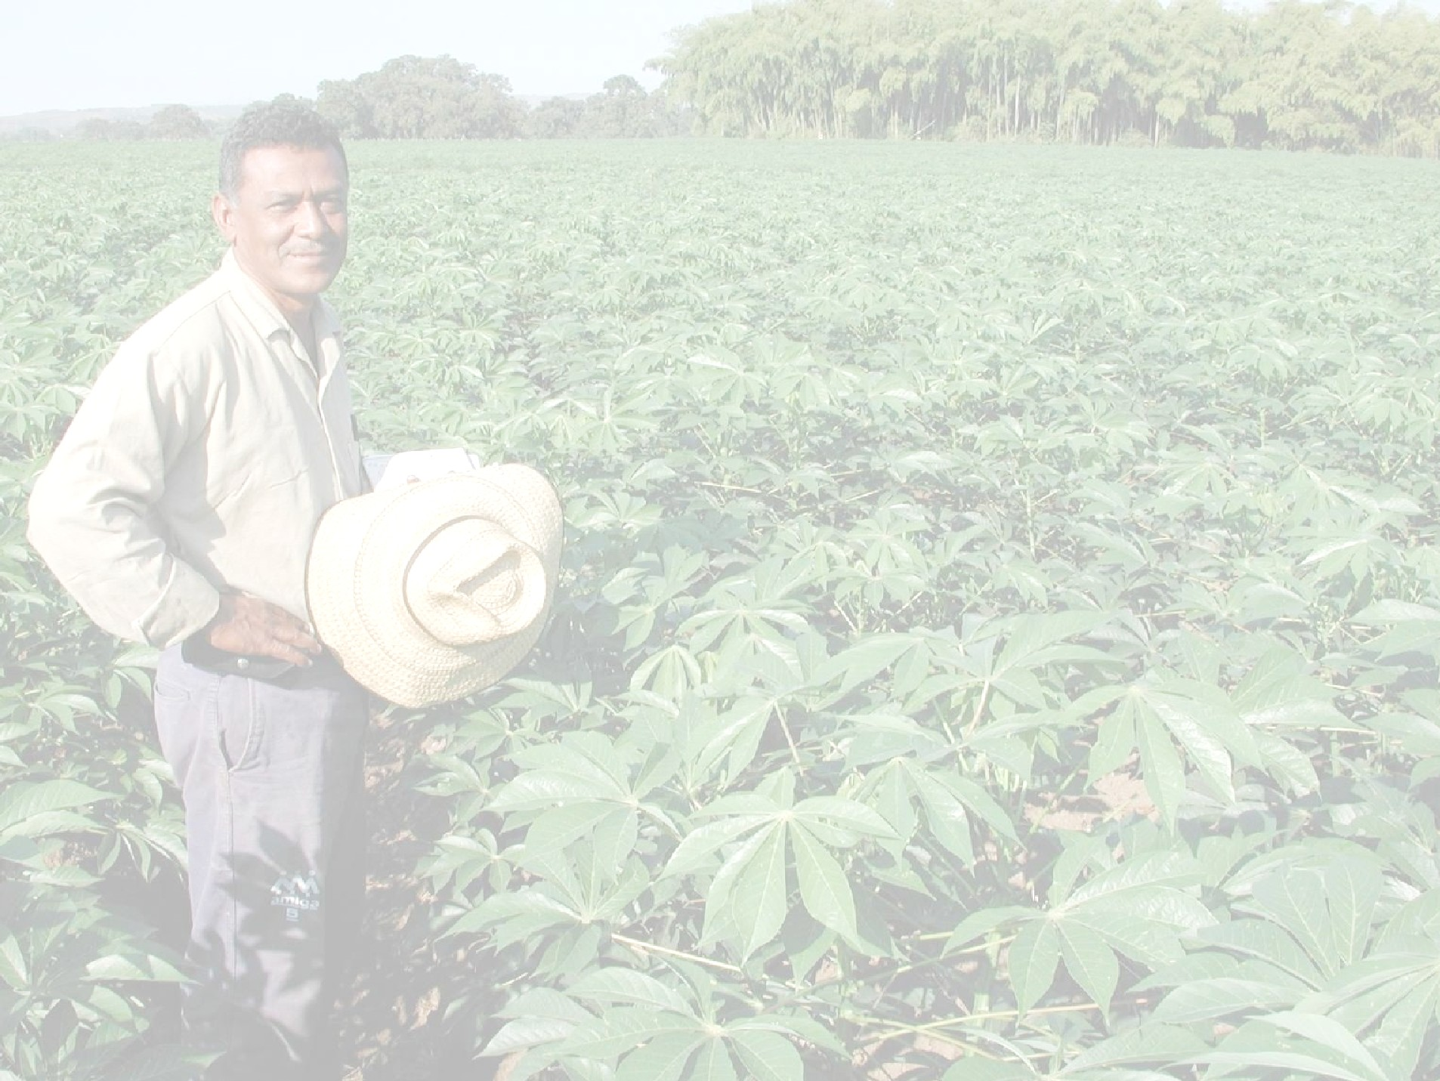
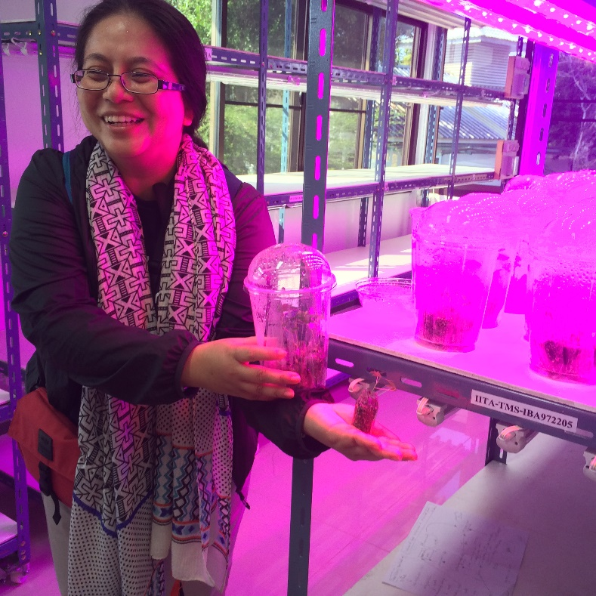
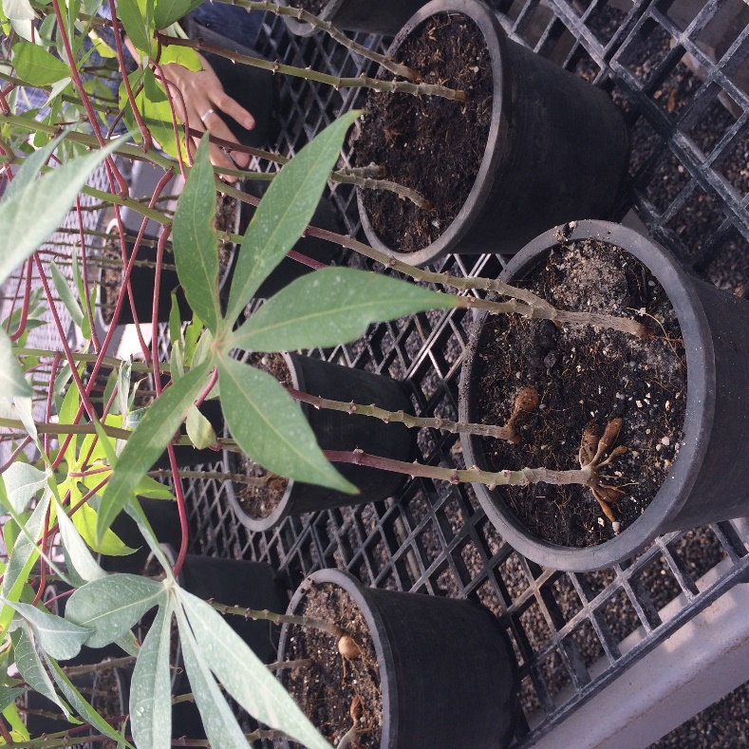
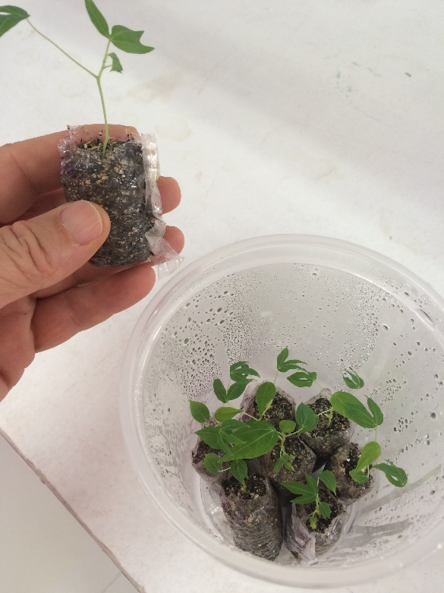
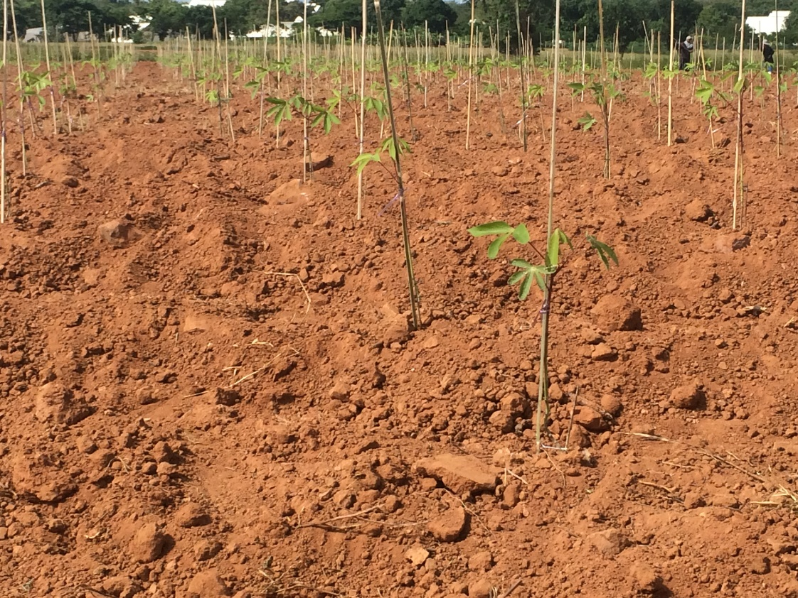
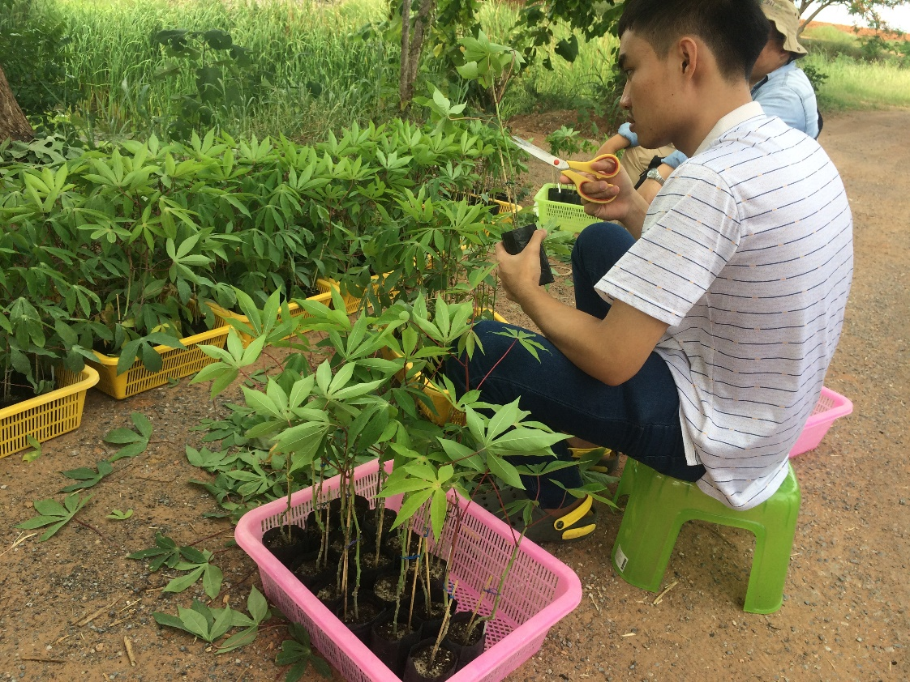
Breeding and deployment of cassava clones
with CMD resistance in SE Asia
Hernán Ceballos (CIAT) and Peter Kulakow (IITA)
Driving principle:
A plant from an introduced clone that can survive CMD is better than a dead plant from a Thai variety (even though it is not as good, genetically speaking)
Available sources of CMD-resistant clones:
The original sources introduced in 2011
New sources from Africa generously shared by IITA
New sources from India carrying CMD₂
Introduced segregating populations (carrying CMD₂)
Segregating populations (carrying CMD₂) produced locally
Screen germplasm collection for resistance to CMD and witches broom

Slide 18
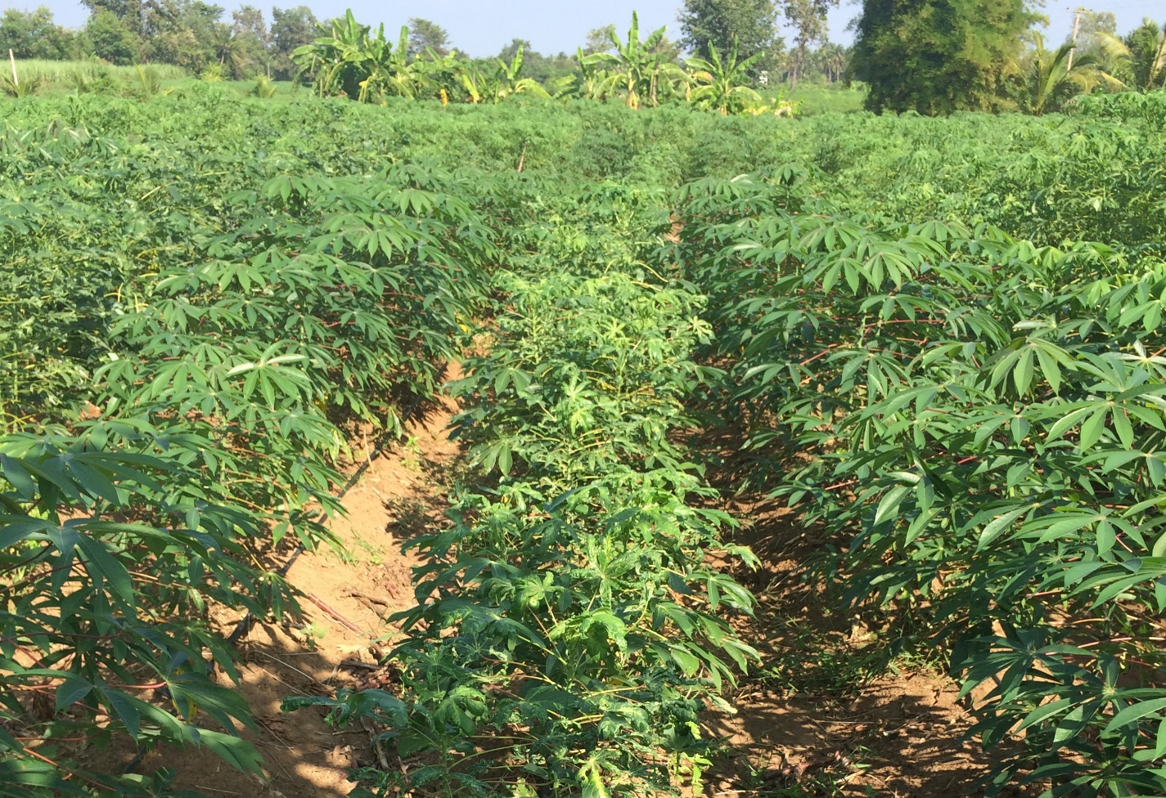
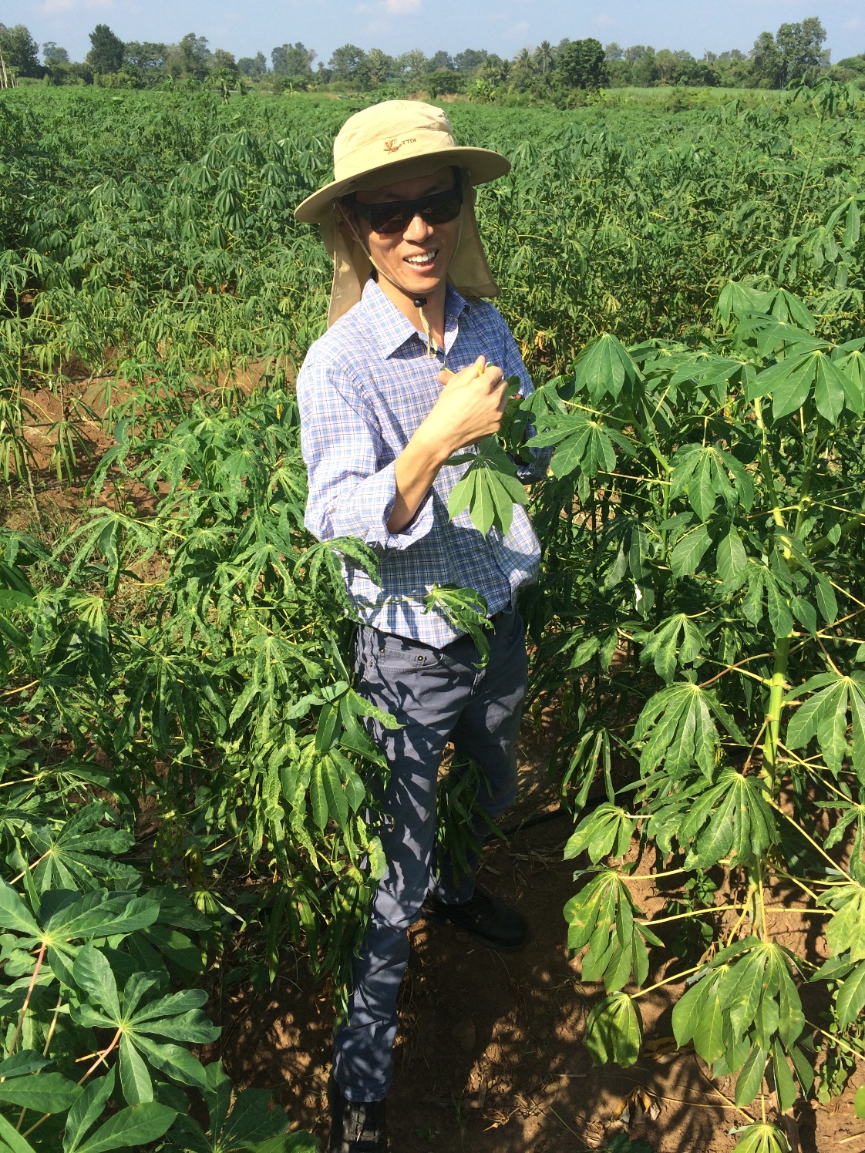
Incidence of CMD in elite cassava germplasm
Slow
infection
Slow
infection
SC8
Plant recovery
Rayong 11
Rayong 11
HB60
KM 98-1
Rayong 5
KU50
Quick
infection
Waxy 1
clone

Slide 19
The first lines of defense against CMD
Germplasm without CMD₂
KU50
R72
Clean planting material
Normal starch
Insecticide-treated cuttings
Waxy starch
Wx 1
Elimination of diseased plants
Germplasm carrying CMD₂
➢TME3 & C33
123-1
179-3
179-4
179-5
➢TME3 & C33 x Thai Clones
Already in
Thailand and
under rapid
multiplication
schemes
TME B419
TMS-IBA-980581
TMS-IBA-980505
TMS-IBA-972205
TMS-IBA-920057
➢IITA Elite clones
➢Commercial varieties from India
(Sree Reksha, Sree Sakthi & 8 S-501)
Hopefully by 2020

Slide 20
Inventory, distribution & management of disease resistance germplasm from CIAT: CMD and other cassava diseases
Hernán Ceballos
Introduction: the honeymoon is over
Management options
Deployment of resistant varieties
➢ Introduced germplasm
➢ Development of CMD resistant clones
Deployment of resistant varieties
➢ Development of CMD resistant clones

Slide 21

lessons from the first generation of waxy starch cassava
Introgressing a single gene trait in cassava is inefficient
⇨ we lost 40 years of breeding with the waxy starch trait
A key problem is the limited number of meiotic events leading to the “F2” plants evaluated
⇨ undesirable linkages remain unbroken
Selected waxy genotypes did not have a nice plant architecture and DMC was low
⇨ New crosses made among selected plants originated the 2nd generation of waxy starch clones
Production of CMD-resistant germplasm in SE Asia will benefit from, at least, 2-3 successive meiotic events
We need to manipulate flowering in crossing nurseries

Slide 22

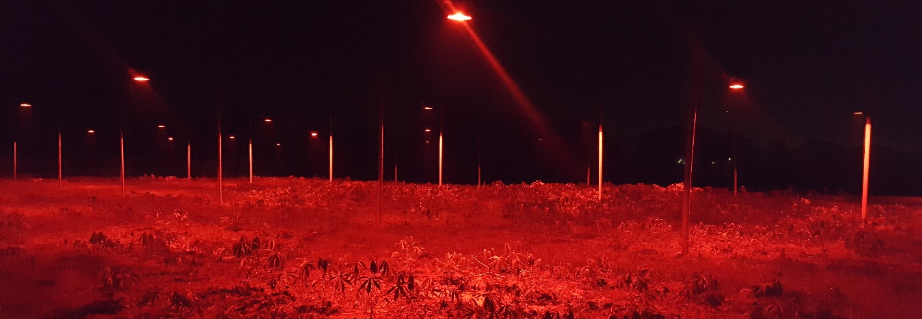
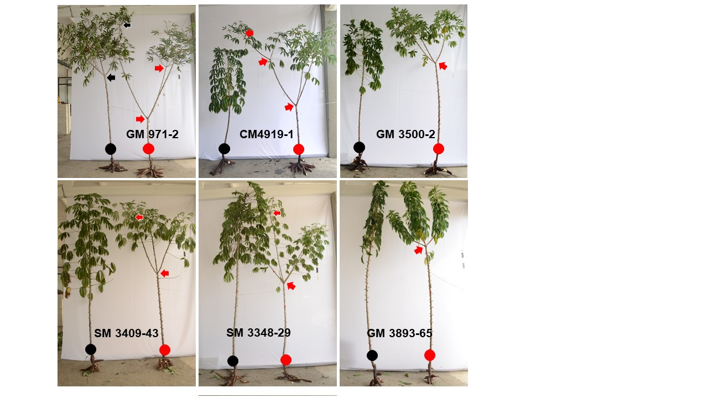
Extention of photoperiod with red lights

Slide 23
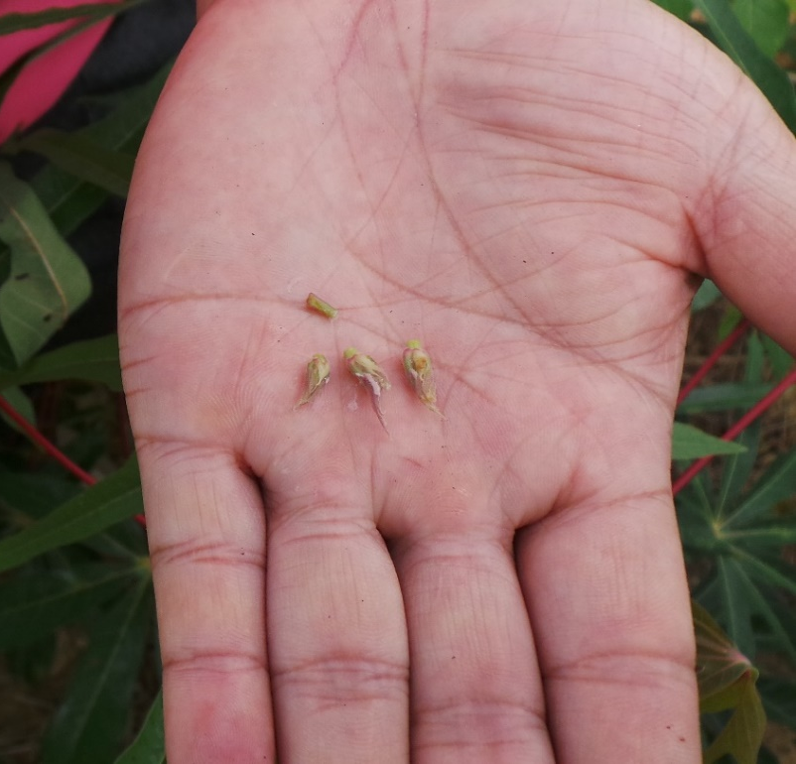
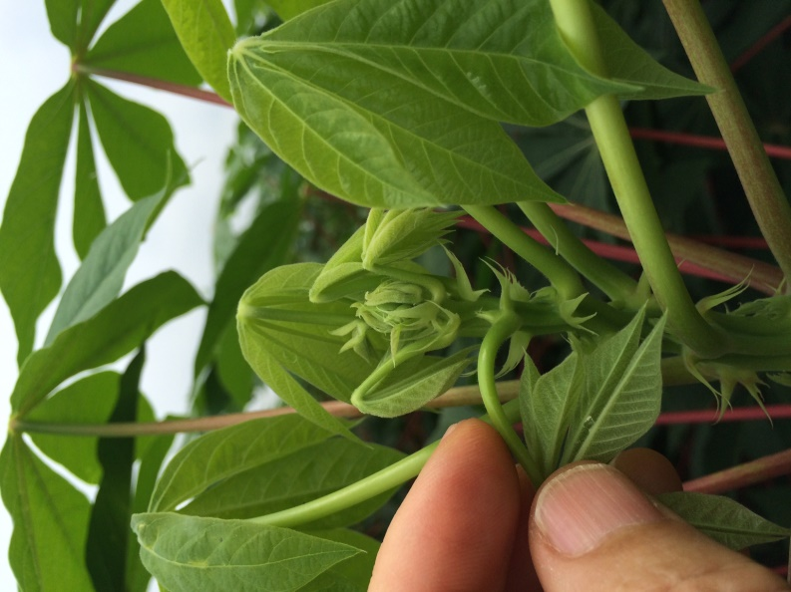
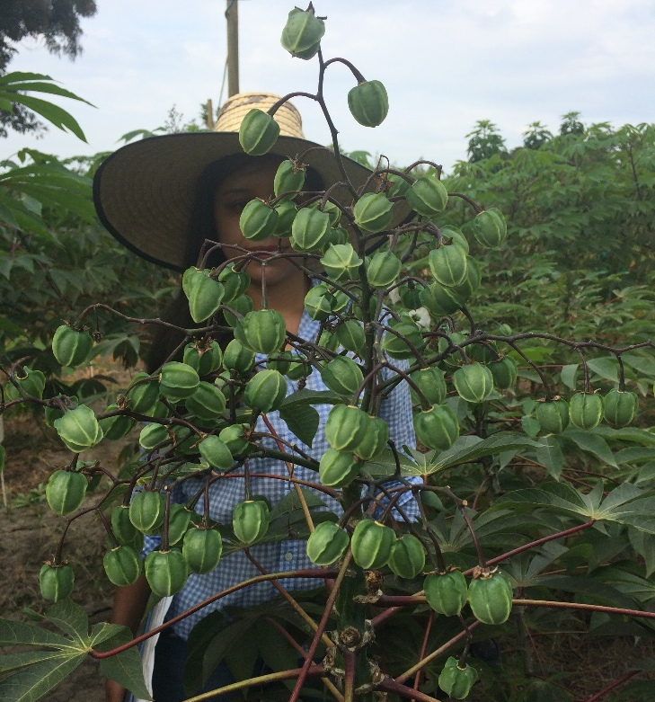
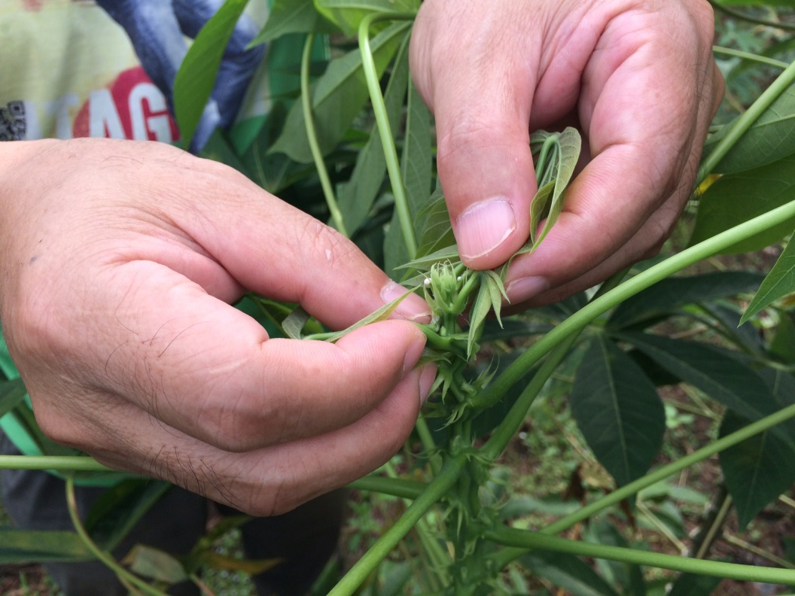
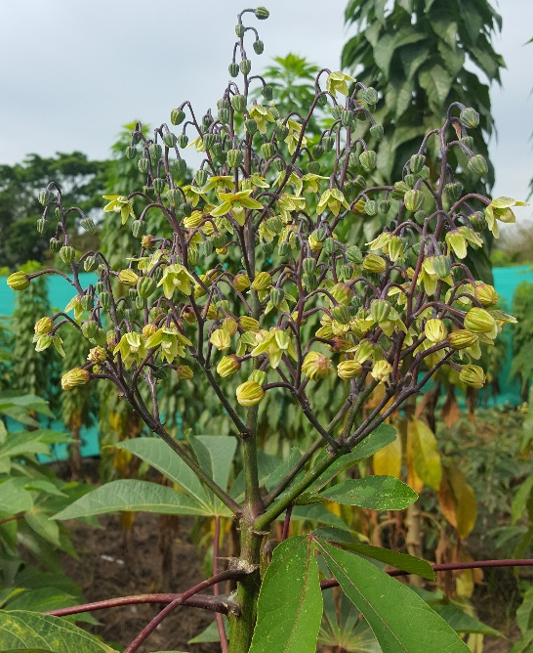
Induction of flowering II: pruning young branches
➢ Branch removal directs energy to the inflorescence: seeds from 1st flowering (usually sterile) can be obtained
➢ The trick is to prune VERY YOUNG branches
➢ Flowering must have already been triggered
➢ Combined with application of BA plenty of hermaphrodite flowers

Slide 24
Development of CMD-resistant germplasm in Thailand
This is a straight forward process (except for the need of a quick outcome):
1. Cross elite Thai germplasm x sources of CMD₂
URGENT: priority to crosses using the NEW IITA clones
2. Based on previous experience with waxy starch more than one recombination event is highly desirable
(cross non-related F1 genotypes, cross back with elite Thai clone, etc.)
Select for CMD₂
Select for good agronomic performance

Slide 25
Development of CMD-resistant germplasm in Thailand
However there is a lot of innovation that can be implemented to speed un and make the selection a bit more efficient.
2020 2021 2022 2023 2024
Seedling
Single row
Preliminary
Advanced
Regional
Selected materials used
as progenitors
Advanced
Regional
Advanced
…
Regional
Regional

Slide 26
Development of CMD-resistant germplasm in Thailand
However there is a lot of innovation that can be implemented to speed up and make the selection a bit more efficient.
2020 2021 2022 2023 2024
Seedling
Single row
Preliminary
Advanced
Regional
Selected materials used
as progenitors
Advanced
Regional
Advanced
…
Regional
Regional
Seedling
Single row
Preliminary
Regional
F1C1
(3 cuttings/
Seedling)
Single row
Preliminary
Regional
…
Single row
Preliminary
Regional
Regional

Slide 27
The importance of single row trials in three locations
Relationship of dry matter content (DMC) of ≈ 150 clones in SRT grown in three different locations
DMC comparison: Sabana vs Sahagún
The magnitude of GxE is
surprisingly high, even for DMC

Slide 28
Development of CMD-resistant germplasm in Thailand
2020 2021 2022 2023 2024
Seedling
F1C1
2nd generation
CMD-resistant germplasm
F1C1
Seedling
F1C1
Single row
Preliminary
Regional
F1C1
(3 cuttings/
Seedling)
Select best genotypes
(across 3 locs)
from best families
(reaction to CMD, harvest
index, root yield potential,
plant type, (DMC?)
Crossing nursery
Rapid multiplication
Single row trials
Full- and half-sib
family data (3 locs)
Single row
Preliminary
Regional
…
Single row
Preliminary
Regional
Regional
1st generation of released
CMD-resistant varieties

Slide 29
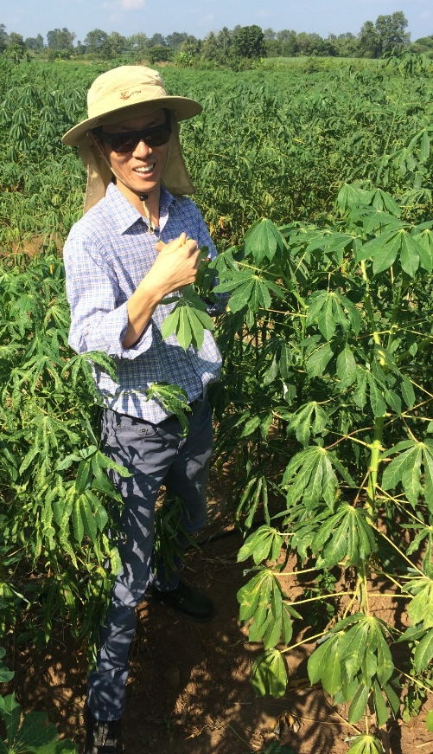
Developing waxy & CMD-resistant germplasm in Thailand
Wx1
Wx2, Wx3, Wx4, Wx5, Wx6
TME B419
TMS-IBA-980581
TMS-IBA-980505
TMS-IBA-972205
TMS-IBA-920057
x IITA new clones
20-100 F1 genotypes (carying CMD₂)
F2 genotypes (waxy & carying CMD₂)
Phenotypic selection pipeline
Additional recombinations

Slide 30
We MUST deliver a solution to farmers
We have the strategic support from IITA
Key question:
“How quickly
can we help
this woman?”
Knowing the “enemy”
Experience dealing with it
Understanding its dynamics
Relevance of seed systems
CMD-resistant clones
Our answer:
Acknowledge the urgency
Prepare for the worst
Do everything we can
Do it NOW
We know what to do &
have access to resistance

Slide 31
Thank you for your attention

